Slide 1
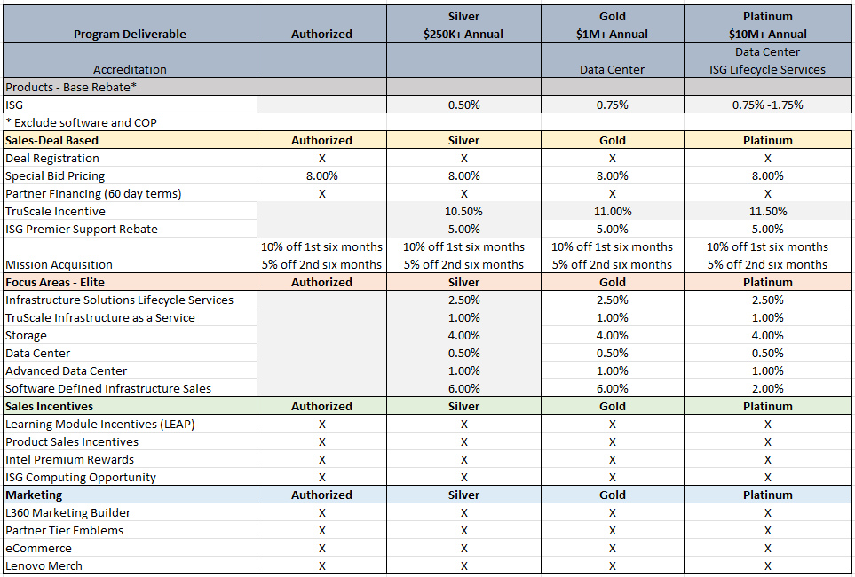
Lenovo ISG – Partner Program

