Slide 1
Lenovo Onboarding Deck

Slide 2


Business Groups
IDG
(Intelligent Devices Group)
Comprised of the PCs and Smart Devices (PCSD) and the Mobile Business Group (MBG) areas, this is our portfolio of products, solutions, software, and services.
ISG
(Infrastructure Solutions Group)
As the only data center provider with end-to-end manufacturing, we offer a comprehensive suite of infrastructure solutions that encompass the entire technology stack of organizations of all sizes.
SSG
(Solutions and Services Group)
SSG brings together all of Lenovo’s IT solutions and services across PC, infrastructure, and smart verticals, including attached and managed services, as-a-service, and our Truscale (Xaas) flagship offerings.

Slide 3
Business Groups Solutions and Verticals
Intelligent Devices Group (IDG)
Solutions
PC’s, smartphones, Smart collaboration, security, and augmented and virtual reality (AR/VR)
Verticals
Commercial enterprise businesses of all sizes, from SMB to large enterprise, encompassing verticals such as Health and Life Sciences, Education, and Telco.
Infrastructure Solutions Group (ISG)
Solutions
Edge and cloud computing, analytics and AI, and Infrastructure-as-a-Service via TruScale.
Verticals
Organizations of all sizes to power smarter Retail, Manufacturing, Healthcare, Finance, and beyond.
Solutions and Services Group (SSG)
Solutions
Business, Industry, and Technology solutions that transform vision into value for the digital workspace, the hybrid cloud, sustainability, and industry specific needs.
Verticals
End-to-End solutions, delivered as-a-service, for Retail, Education, Buildings & Facilities, and Manufacturing.

Slide 4
How Lenovo works?

Slide 5
Distribution
Lenovo currently works through a distribution channel, that means that as a partner you have the choice to have more than one distributor that will allow you to get the inventory that you need at a reasonable price.
Ingram
US: Home · Ingram Micro Partner Registration (ingrammicroresellerapplication.com)
CA: Become A Reseller (ingrammicro.com)
Contact info:
US: smb.lenovo@ingrammicro.com
CA: CanadaCentralSMB@ingrammicro.com
D&H
US: Become a D&H Customer (dandh.com)
CA: Become a D&H Customer (dandh.ca)
Contact info:
US: lenovospecialist@dandh.com
CA: lenovocanadainbox@dandh.com
ISG US: lenovo.servers@ingrammicro.com
ISG CA: LenovoISG@ingrammicro.com
ISG US: lenovoserver@dandh.com
TD Synnex
US: https://www.tdsynnex.com/na/us/become-a-customer/
CA: https://www.tdsynnex.com/na/ca/become-a-customer/
Contact info:
US: LenovoSMB@synnex.com
CA: thinklenovo@techdata.ca
Arrow
US & CA: Become A Channel Partner | Arrow ECS NA
Contact info:
US: lenovosales@arrow.com
ISG US: Lenovodatacenter@TDSYNNEX.com / LenovoESG@synnex.com
ISG CA: Gary Cheung ManHinGary.Cheung@tdsynnex.com

Slide 6
Financial Programs

Slide 7
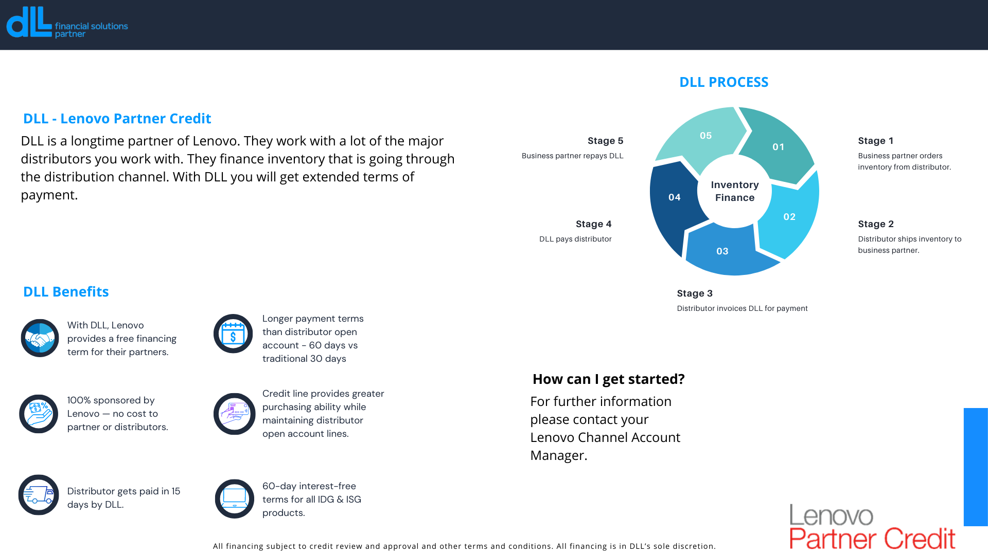
DLL
Apply Here!

Slide 8
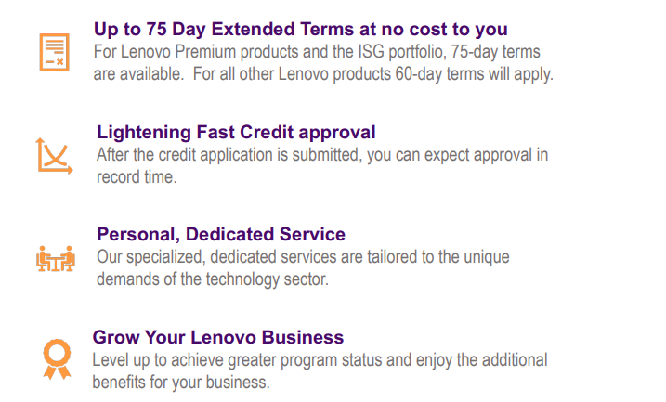
Northpoint Commercial Finance
Begin purchasing with Lenovo today and gain access to attractive financing to support your business growth. Lenovo and Northpoint Commercial will give you access to credit with attractive rates and terms, quickly and easily.
Start your journey with Northpoint by completing our simple credit application at: http://www.northpointcf.com/application
Have questions?
Email: techfinance@northpointcf.com

Slide 9
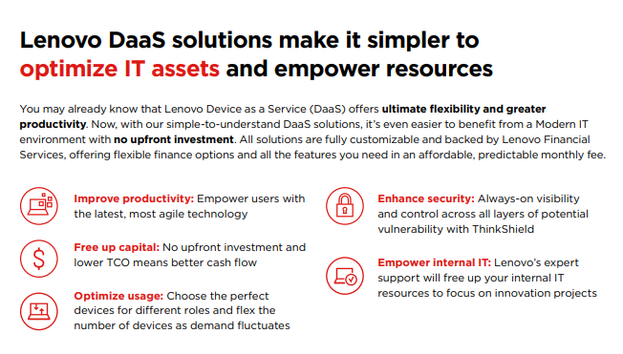
DaaS
Learn More!

Slide 10
Partner Tiering

Slide 11

April 1st - FY25 requirements
Tiering Assessments
April 1, 2024
Upgrades and downgrades evaluated, based on FY25 Revenue (April 1, 2023, until March 31, 2024).
May 17, 2024
Deadline for Specialist Accreditations.
July 1, 2024
Adjustments to tiers if missing Specialist Accreditations.
October 1, 2024
Upgrades evaluated, based on:
Revenue requirements met (Data: April 1, 2024, until Sept 30, 2024)
Accreditations

Slide 12
Tiering Requirements – Discrete
 | Silver | Silver | Gold | Gold | Gold | Platinum | Platinum | Platinum
Discrete Tiers | IDG | ISG | IDG | IDG | ISG | IDG | ISG | ISG
Annual Revenue¹ | $250,000 | $250,000 | $1,000,000 | $1,000,000 | $1,000,000 | $10,000,000 | $10,000,000 | $10,000,000 |  |  | NOTE: You must be registered to the Lenovo Partner Hub to access the accreditations.
IDG Accreditations ² |  |  | 2 | 2 |  | 3
ISG Accreditations ² |  |  |  |  | 2 |  | 3 | 3
Notes:
1 Annual Revenue for discrete tiers includes hardware, Services & Software
2 Accreditation attainment must align to business unit
Tiering Multipliers - May help a partner achieve a tier sooner
ISG Services & ISG Storage x 8
IDG Services & Software x 4
IDG Accreditations |  | Required #1 |  |  |  | Required #2 |  |  |  |  | Required #3 |  | Approx. Time Commitment - Tiering
Workstation |  | Workstation Credential |  |  |  |  |  |  |  |  |  |  | Courses: ~ 1.5 hours + Assessment: ~ 30 minutes
Smart Collaboration |  | Smart Collaboration Credential |  |  |  |  |  |  |  |  |  |  | Courses: ~ 1.5 hours + Exam: ~ 30 minutes
Modern Workplace |  | Modern Workplace |  |  |  |  |  |  |  |  |  |  | Varies depending on chosen courses
Intelligent Devices Lifecycle Services |  | Intelligent Devices Support Services Credential |  |  |  | Intelligent Devices Configuration Services Cred. |  |  |  |  | Sustainability Services Credential |  | Courses: ~ 2.25 hours + Assessments: ~ 1.5 hours
TruScale Device as a Service |  | TruScale DaaS Credential |  |  |  |  |  |  |  |  |  |  | Courses: ~ 1.5 hours + Assessment: ~ 30 minutes
ISG Accreditations |  | Required #1 |  |  |  | Required #2 |  |  |  |  | Required #3 |  | Approx. Time Commitment - Tiering
Infrastructure Solutions Lifecycle Services |  | Infrastructure Support Services Credential |  |  |  | Infrastructure Managed Services Cred. |  |  |  |  | Sustainability Services Credential |  | Courses: ~ 2.5 hours + Assessments: ~ 1.5 hours
TruScale Infrastructure as a Service |  | TruScale Infrastructure as a Service Credential |  |  |  |  |  |  |  |  |  |  | Courses: ~ 1.5 hours + Assessment: ~ 30 minutes
Software Defined Infrastructure Sales |  | Client Virtualization Sales Credential |  |  |  | Data and Analytics Sales Cred. |  |  |  |  | Lenovo Cloud Sales Cred. |  | Courses: ~ 4.5 hours + Assessments: ~ 1.5 hours
Software Defined Infrastructure Solutions |  | LENP-330 | Client Virt. Solutions Technical Sales |  |  | LENP-331 | Data & Analytics Solutions Tech Sales |  |  |  | LENP-332 | Cloud Solutions Technical Sales | Courses: ~ 16.25 hours + Exams: ~ 4.5 hours
Storage |  | LENU-120C | Storage Sales Learning Path |  |  |  |  |  |  |  |  |  | Courses: ~ 5.5 hours + Exam: ~ 1.25 hours
Data Center |  | LENU-119C | Data Center Sales |  |  |  |  |  |  |  |  |  | Courses: ~ 12 hours + Exam: ~ 1.5 hours
Advanced Data Center |  | TruScale Infrastructure as a Service Credential |  |  |  | LENU-319C | Data Center Technical Sales |  |  |  |  |  | Courses: ~ 12 hours + Exam: ~ 1.5 hours + Assess: ~ 30 min.
If you are logged into LPH (or LPL - Lenovo Partner Learning), you can access the links to the Accreditations
* Software Defined Infrastructure Sales – If a partner fulfills all Software Defined Infrastructure Sales Elite requirements, they can count that towards the tiering requirements in lieu of the requirements noted above for Software Defined Infrastructure Sales

Slide 13
Gold 360 & Platinum 360 Tiering Requirements
Lenovo360 Tiers |  | Gold 360 |  | Platinum 360
Total Annual Revenue ³ |  | $1,000,000 |  | $10,000,000
Minimum revenue IDG ⁴ |  | $250,000 |  | $1,000,000 |  | Tiering Multipliers - May help a partner achieve a tier sooner ISG Services & ISG Storage x 8 IDG Services & Software x 4 NOTE: Platinum 360 partners are required to select 2 different Accreditations to meet tiering criteria, rather than choosing 2 of the same Accreditation.
Minimum revenue ISG ⁵ |  | $250,000 |  | $1,000,000 |  | Tiering Multipliers - May help a partner achieve a tier sooner ISG Services & ISG Storage x 8 IDG Services & Software x 4 NOTE: Platinum 360 partners are required to select 2 different Accreditations to meet tiering criteria, rather than choosing 2 of the same Accreditation.
SSG Revenue ⁶ |  | $25,000 |  | $300,000
IDG Accreditations |  | 1 |  | 2 |  | Tiering Multipliers - May help a partner achieve a tier sooner
ISG Accreditations |  | 1 |  | 2 |  | ISG Services & ISG Storage x 8
SSG Accreditations |  | 1 |  | 2 |  | IDG Services & Software x 4 NOTE: Platinum 360 partners are required to select 2 or 3 different Accreditations to meet tiering criteria, rather than choosing 2 or 3 of the same Accreditation..
Notes:
3 Lenovo 360 total revenue multiplies IDG embedded services x 4
4 Lenovo 360 Tiers IDG Revenue excludes services & software
5 Lenovo 360 Tiers ISG Revenue excludes services but includes software
6 Lenovo 360 Tiers SSG Revenue includes IDG Services (including embedded services) & Software + ISG Services
IDG Accreditations | Required #1 |  | Required #2 |  | Required #3 |  | Approx. Time Commitment - Tiering
Workstation | Workstation Credential |  |  |  |  |  | Courses: ~ 1.5 hours + Assessment: ~ 30 minutes
Smart Collaboration | Smart Collaboration Credential |  |  |  |  |  | Courses: ~ 1.5 hours + Exam: ~ 30 minutes
Modern Workplace | Modern Workplace |  |  |  |  |  | Varies depending on chosen courses
SSG Accreditations | Required #1 |  | Required #2 |  | Required #3 |  | Approx. Time Commitment - Tiering
Intelligent Devices Lifecycle Services | Intelligent Devices Support Services Credential |  | Intelligent Devices Configuration Services Cred. |  | Sustainability Services Credential |  | Courses: ~ 2.25 hours + Assessments: ~ 1.5 hours
TruScale Device as a Service | TruScale DaaS Credential |  |  |  |  |  | Courses: ~ 1.5 hours + Assessment: ~ 30 minutes
Infrastructure Solutions Lifecycle Services | Infrastructure Support Services Credential |  | Infrastructure Managed Services Cred. |  | Sustainability Services Credential |  | Courses: ~ 2.5 hours + Assessments: ~ 1.5 hours
TruScale Infrastructure as a Service | TruScale Infrastructure as a Service Credential |  |  |  |  |  | Courses: ~ 1.5 hours + Assessment: ~ 30 minutes
ISG Accreditations | Required #1 |  | Required #2 |  | Required #3 |  | Approx. Time Commitment - Tiering
Software Defined Infrastructure Sales | Client Virtualization Sales Credential |  | Data and Analytics Sales Cred. |  | Lenovo Cloud Sales Cred |  | Courses: ~ 4.5 hours + Assessments: ~ 1.5 hours
Software Defined Infrastructure Solutions | LENP-330 | Client Virt. Solutions Technical Sales | LENP-331 | Data & Analytics Solutions Tech Sales | LENP-332 | Cloud Solutions Technical Sales | Courses: ~ 16.25 hours + Exams: ~ 4.5 hours
Storage | LENU-120C | Storage Sales Learning Path |  |  |  |  | Courses: ~ 5.5 hours + Exam: ~ 1.25 hours
Data Center | LENU-119C | Data Center Sales |  |  |  |  | Courses: ~ 12 hours + Exam: ~ 1.5 hours
Advanced Data Center | TruScale Infrastructure as a Service Credential |  | LENU-319C | Data Center Technical Sales |  |  | Courses: ~ 12 hours + Exam: ~ 1.5 hours + Assess: ~ 30 min.
If you are logged into LPH (or LPL - Lenovo Partner Learning), you can access the links to the Accreditations
* Software Defined Infrastructure Sales – If a partner fulfills the Software Defined Infrastructure Sales Elite requirements, it will count towards tiering.

Slide 14
Partner Programs & Tools

Slide 15









Partner Emails
LPH (Lenovo Partner Hub) Your One Stop Shop For Everything You Need To Know
Content Syndication
Social Media
Podcasts
Partner Marketing
https://www.lenovopartnerhub.com/
Videos
Partner Communities
Virtual Events

Slide 16
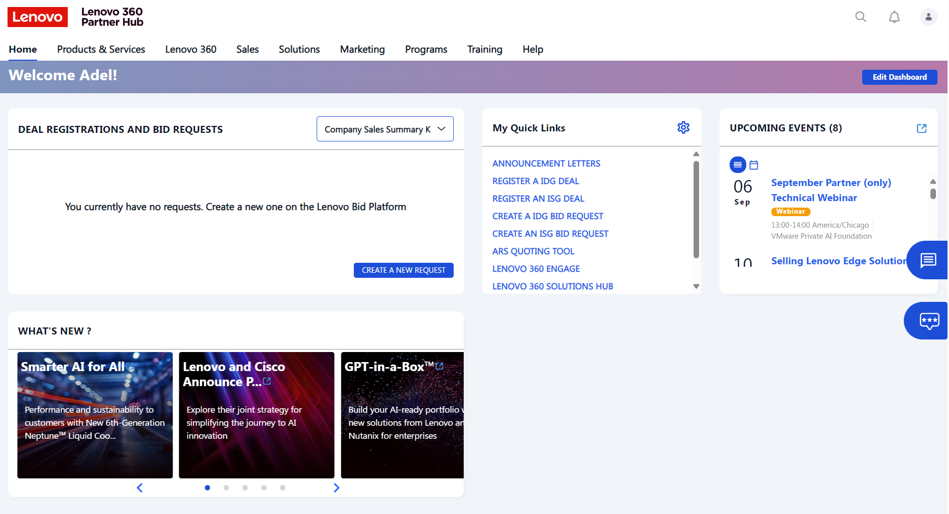
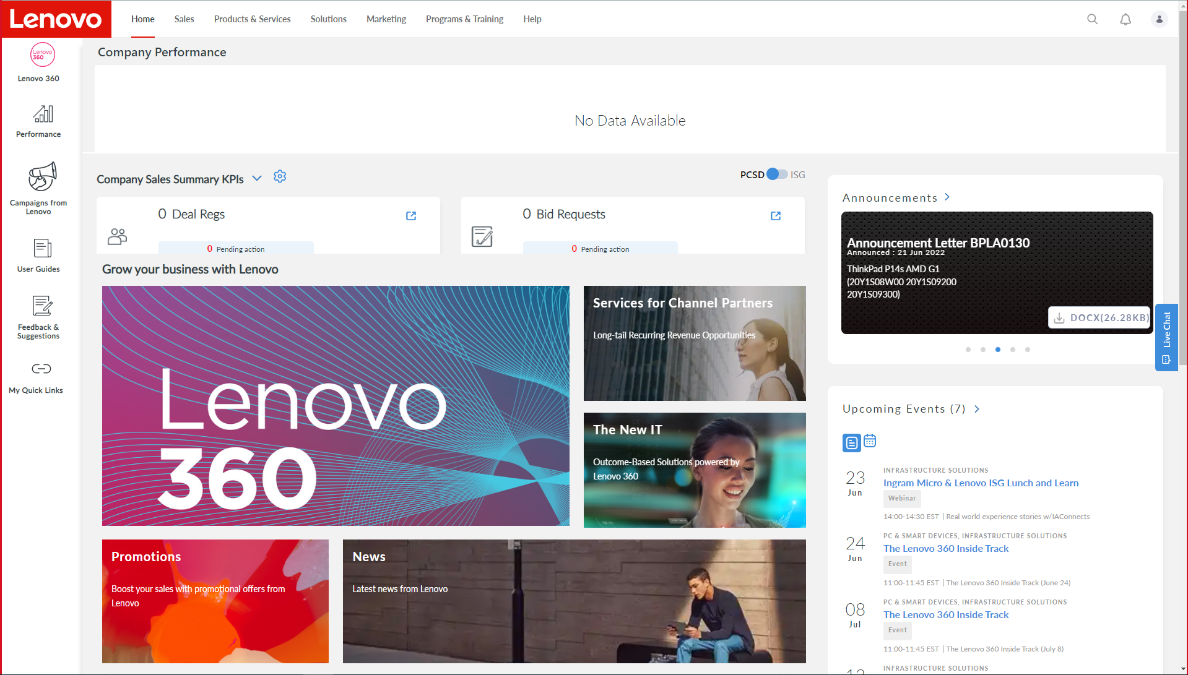
Company information
Dashboards to keep a track of the company performance, quarter by quarter
Access to LBP to create and check the created DR’s and BR’s

Slide 17
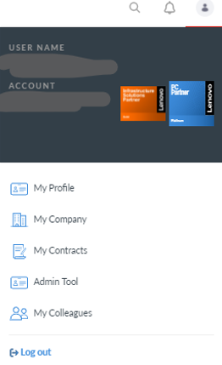
LPH – Managing Users & Profiles
In LPH, the users with the system role set as Admin can manage LPH participants and their profiles.
Steps:
Log in to the LPH
Go to My Profile (Upper Right Side)
Click My Colleagues
Add participants or edit the roles as required
Admins Compared to Leading Financial Contact:
Payment notifications - Sent to Leading Finance Contact (LFC) unless one is not designated, in which case, they are sent to Full Admins
Full Admins and Leading Finance Contact can access and change bank information
To update the Lenovo Program Letter distribution list, complete this Smartsheet Form
Step 2
Step 3

Slide 18
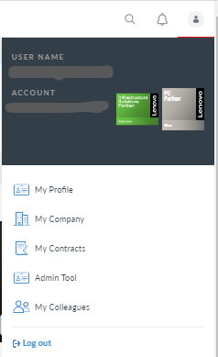
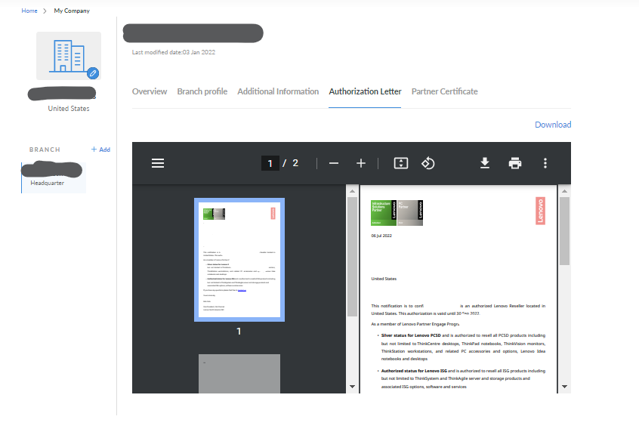
Letter of Authorization
Letters of authorization can be downloaded from LPH (by LPH Administrators) by following these steps:
Login to LPH
Click on the person (top right corner)
Click “My Company”
Click “Authorization Letter”
Print (option to print to .pdf)

Slide 19
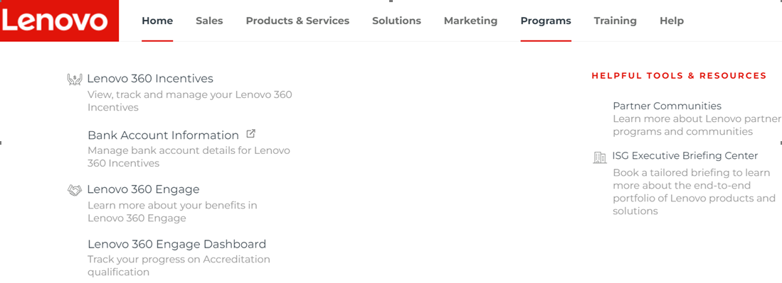
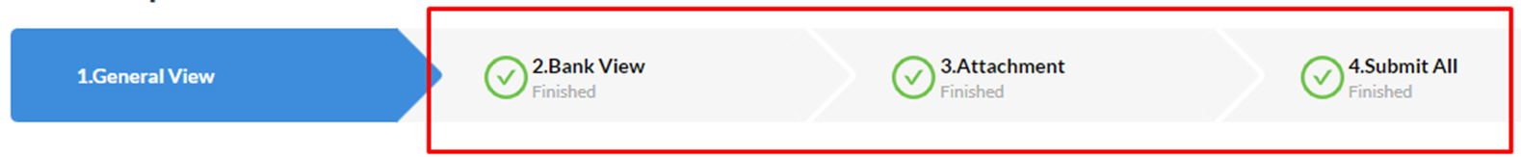
LPH - Banking Information
Payments are sent to the bank account defined in LPH. Your LPH Admin (or Leading Financial Contact if your company designated one) can view & change this information.
If you aren’t receiving payments, check to see if the payments are going to the correct account.
You have 180 days to submit banking information. After 180 days, outstanding payments will be forfeited.
If the banking info is changed, your LPH Admins (or Leading Financial Contact if your company designated one) will be notified but additionally you must alert Lenovo by sending an email to pcsdprograms@lenovo.com
Set up Banking info in LPH:
Enter all info and ensure that “Submit All” is checked off:
It takes a couple of weeks for Lenovo to validate the information and create the vendor code.

Slide 20
Deal Registration & Special Bid Pricing
 | IDG Deal Reg (not SMB) | IDG SMB Deal Reg | ISG Deal Reg
Special Bid Pricing granted for | A specific opportunity (has an assigned Lenovo end user rep) | A specific customer (classified as a SMB account) that isn’t covered by a Lenovo end user rep. | A specific customer account
Available to | Partner with Approved Deal Reg | Partner with Approved Deal Reg | Partner with Approved Deal Reg
Deal size | - | - | -
Duration | 6 months | 6 months | 6 months
Benefit | 5% Exclusive up front pricing discount 10% Smart Collaboration exclusive up front pricing discount | 5% Exclusive up front pricing discount | 8% Exclusive up front pricing discount
Step 1: Apply for a Deal Reg. for your customer/customer account (if you don’t already have one).
Step 2: Create Special Bid request(s) for that customer/customer account.
Login to the Lenovo Partner Hub (LBP-E) to apply.
Notes:
Investment Review – IDG April 20

Slide 21
Not for Resale (NFR)
When a partner is not transferring title to an end customer.
NFR (Not for Resale) quotes are for Partner Internal Use only. Examples may include:
Internal Use (production)
Demo
Managed Services (separate program)
Process
If your partner doesn’t have a SMB End Customer Record because they have a LE, PS, or Education account, go to the Lenovo End User rep who covers that account for pricing, otherwise follow this process
Login to LPH
Click Sales
Click Create a Bid Request
Price Grid = Choose SMB Base Grid
End Customer Name = Your company’s name
Search, Choose, Save
Choose Bid Sub Type = BP Internal
Request Price
Complete Bid Request

Slide 22

LEAP: Learn & Earn
Develop your sales and technical skills!
LEAP online training is fully integrated into the Lenovo Partner Learn platform. New and relevant courses are updated in LEAP regularly to help you sell Lenovo products and solutions more effectively.
Earn points for taking courses and for capturing your Lenovo certifications in LEAP.
Translate the points you earn into gift cards, merchandise, and/or a reloadable Lenovo Mastercard.
Internal Info

Slide 23






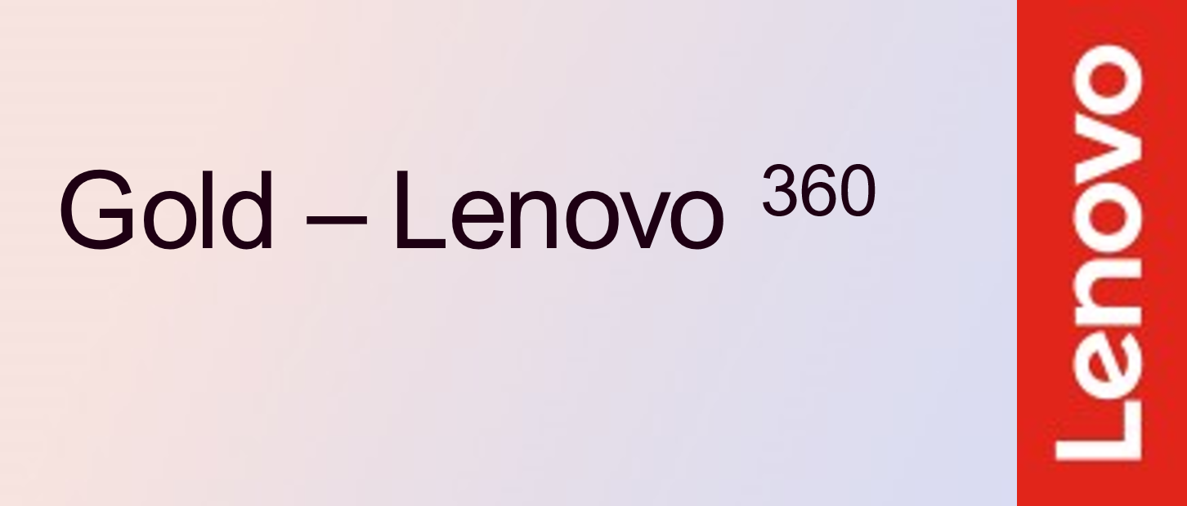
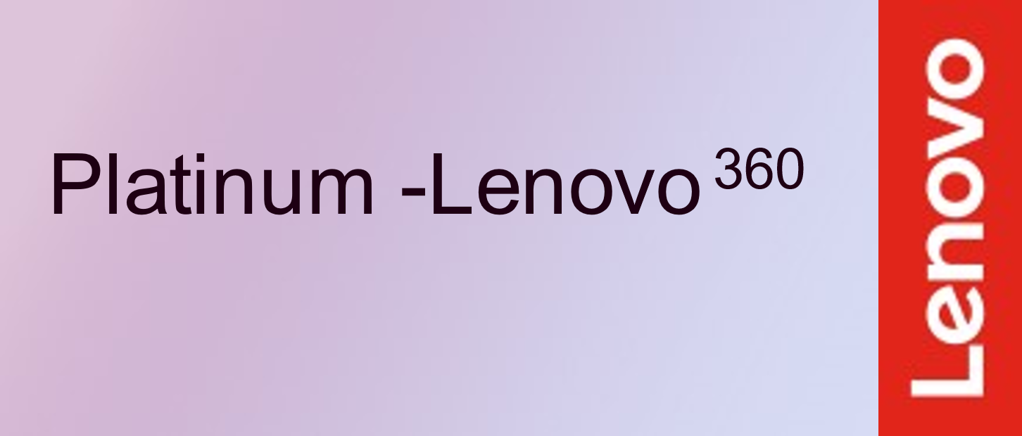
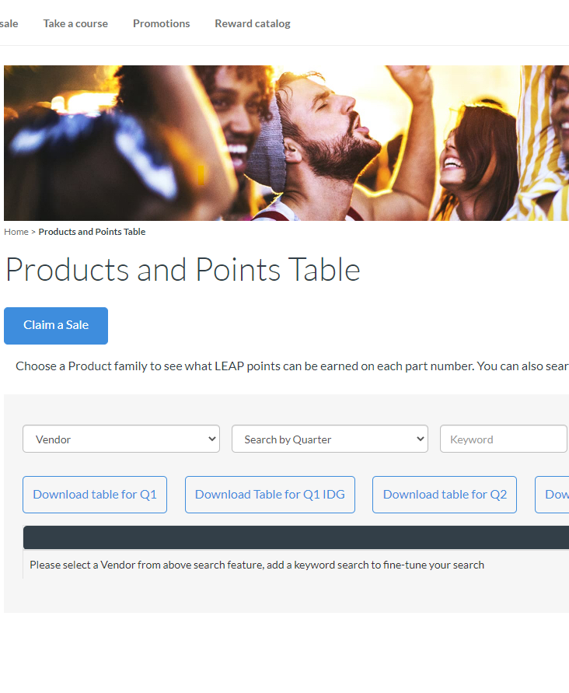
LEAP: Sell & Earn
Earn points when you sell eligible products!
Incentives vary by product and are awarded in points. Translate the points you earn into gift cards, merchandise, and/or a reloadable Lenovo Mastercard.
Sell eligible products
Lenovo loads eligible invoices into LEAP
Go to “Claim a Sale” to see your eligible invoices.
Redeem* your LEAP Points
Join LEAP
After you “Claim a sale”, it will take ~ 10 days for the points to go into your account.
To Join:
Login to the Lenovo Lenovo Partner Hub > Programs & Training > LEAP > Accept T&Cs.
View current products (including ISG) and points by logging into LEAP > Claim a Sale > View Products and Points table.

Slide 24





Lenovo 360 Marketing Builder
Automating marketing for better business outcomes
Lenovo 360 Marketing Builder enables partners to:
Create and execute stronger marketing campaigns
Generate and manage qualified leads
Track digital engagements in real-time
All with the speed and ease of seamless, trusted automation.
More information: Lenovo 360 Marketing Builder
24

Slide 25

Lenovo 360 Solutions Hub
A single, centralized sales resource for revenue growth.
The Lenovo 360 Solutions Hub will help you capture more opportunities, deepen customer relationships and increase deal sizes with outcome-based solution selling.
More Info: Lenovo 360 Solutions Hub

Slide 26

Your Lenovo Channel Account Manager
Maryam Abdullah Contact Information:
Email address: mabdullah7@lenovo.com
Phone number: 800 688 9116 Ext.7100166

Slide 27
Resources & Key Contacts
Lenovo Partner Assist:
supporthub@lenovo.com
Site used if partner is having issues with LPH.
Bid Request: supporthub@lenovo.com
Technical support site that can help support technical issues and troubleshooting:
itsupport@lenovo.com
http://support.lenovo.com/us/en
Lenovo VAR Support:
varsupport@lenovo.com

Slide 28
Favorite Resources / Websites
Website / Title | Description
http://lenovopartnerhub.com | Lenovo Partner Hub
http://lbp.lenovo.com | Lenovo Bid Portal
https://www.youtube.com/playlist?list=PLs18hw3X0NC7jhqH753iNl_9EvpvGxRjB | NA Channel Chatter Youtube Channel
http://support.lenovo.com/us/en | Technical support site that can help support technical issues and trouble shooting
https://www.lenovo.com/us/en/compliance/ | Information regarding compliance on exports and imports, environmental impacts, and accessibility
https://pcsupport.lenovo.com/us/en/warrantylookup | Warranty Lookup
https://www.lenovosc.com/ | Lenovo Solutions Center
Product Specifications Reference(PSREF) (lenovo.com) | PSREF
https://ovp.lenovo.com/lenovo-ovp-new/login | Order Visibility Portal

