Slide 1



Modern devices for nonprofits
Nonprofit
With accelerated digital transformation, empower your staff with a device portfolio that enables new AI experiences and secure productivity from anywhere.
Today’s workplace requires modern and secure devices that enable new AI experiences and work seamlessly with modern communications and collaboration tools to empower staff to be more productive and connect with colleagues, volunteers, and donors from anywhere.
Microsoft Surface for Business offers a versatile device portfolio with industry-leading security to empower nonprofit staff and volunteers to deliver effective programs
and accelerate mission outcomes.
Light, versatile, powerful, and AI ready, Surface devices deliver a premium experience that fits the needs of personas across nonprofits, from Volunteer coordinators and volunteers to program fund managers, directors, and back-office staff.
“With Microsoft Surface, we’re providing a highly capable device, reducing down time and decreasing provisioning time with Microsoft Intune and Autopilot. Now Make-A-Wish staff and volunteers can better focus on their passion to serve wish kids across the country.”
Travis Gibson, CISM: Senior Director of Infrastructure, Security, and Operations, Make-A-Wish America
Surface devices with Windows 11 and Microsoft 365 work together to enable a modern workplace while mitigating risk with:
Productivity, collaboration, AI
Cloud-managed devices
Chip-to-cloud security
Experience the best of Microsoft—Microsoft 365, Dynamics 365, Azure, Windows 11, and Microsoft Copilot¹—on a Surface device. Surface + Microsoft Teams enable crystal clear meetings with high-end cameras, optimized microphones, and quality speakers. Enhance collaboration with AI-capabilities on Surface AI PCs and Copilot+ PCs.²
Enable work from anywhere while keeping control with zero-touch deployment and seamless device management. Dispersed staff just unbox and log in. Surface + Microsoft 365 gives them the freedom to work their way and protection by the best modern security and manageability platform from Microsoft.
Security is built into every layer, from the supply chain to the firmware to the operating system, helping to keep data safer than ever. Surface powered by Microsoft 365 helps improve enterprise security. Secured-core PCs, available on select Surface devices, are designed to elevate the benefits of Windows 11 security.
Learn more about Surface for Business

Slide 2
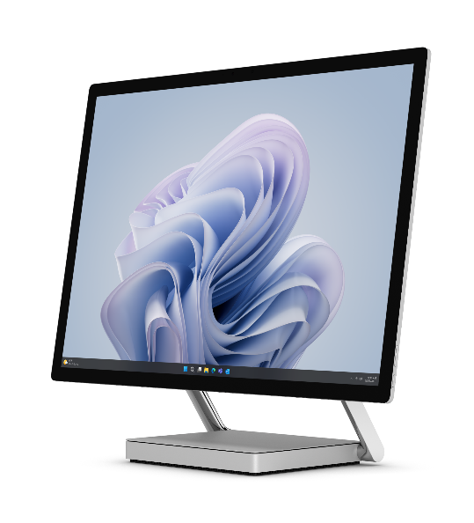
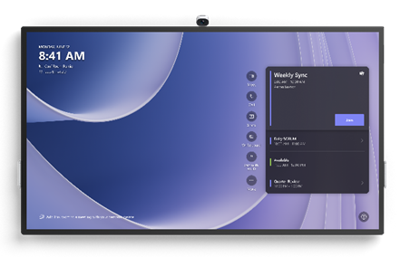
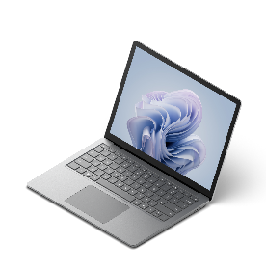
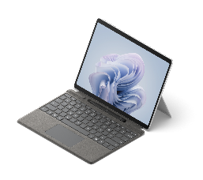
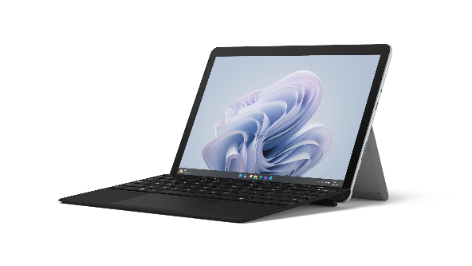




Nonprofit
IMPORTANT:
Copilot in Windows is not available in all Surface markets. Do NOT message or depict Copilot in Windows features and functionality in markets where it is not support or will not be available at launch. For list of markets and required disclosures, go to: Copilot in Windows Storybook Guidance at: https://microsoft.sharepoint.com/teams/Windows11ConsumerStorybookHOL23/SitePages/Copilot%20in%20Windows%2011.aspx)
Disclaimer: Copilot for Microsoft 365 sold separately and requires a qualifying volume license or subscription. https://www.microsoft.com/microsoft-365/enterprise/copilot-for-microsoft-365. Copilot in Windows (in preview) is available in select global markets and will be rolled out to additional markets over time. Copilot with commercial data protection is available at no additional cost for users with an Entra ID enabled, eligible M365 license. Your AI-powered chat for the Web with commercial data protection | Microsoft Copilot (https://www.microsoft.com/en-us/bing/chat/enterprise/?form=MA13FV)
Go
Pro
Laptop
Studio
Hub
Volunteer coordinators
Fundraising Manager
Challenges
Communicating the mission clearly with local volunteers
Documenting events while working remotely
Staying connected to email, meetings, and colleagues
Servicing the changing needs of constituents and volunteers in a hybrid world
Challenges
Staying connected while traveling to meet with donors
Communicating the mission clearly to prospective donors whether onsite or virtually
Collaborating with colleagues and directors on campaigns and donor agreements while on the go
Empower coordinators to drive the mission with Surface Go 4
The smallest and lightest Surface 2-in-1, durable cases,* and extended battery life³ makes it easy to use at events
Premium design projects nonprofit’s professional image
Faster processor speed (than previous Surface Go) to run business-critical software and productivity apps
10.5” PixelSense™ high-resolution touchscreen to present mission images and videos clearly to volunteers and donors
Surface Pen* for e-signatures (go paperless)
Quality speakers, mics, and cameras for video calls to educate volunteers on the mission
A Secured-core PC to elevate Windows 11 security benefits
Help ensure successful fundraising campaigns with
Surface Pro 10
Lightweight, ultra-thin 2-in-1 device with all-day battery³ adapts to where and how managers work
Intel® Core™ Ultra processors with Intel® AI Boost NPU to run business apps, AI experiences, and Windows Studio effects
High quality audio and video for donor calls and training
13” PixelSense™ anti-reflective touchscreen designed for Surface pen*, great for digital notetaking and e-signatures
Rear-facing camera to capture and share photos of effective promotional displays and donor appreciation photo ops
The ultimate desktop experience with Thunderbolt™ 4 or USB-C® ports and Windows 11
New Copilot Key⁴ on Surface Pro (and Pro Flex*) Keyboard
Built-in NFC card reader or Windows Hello for secure sign-in
A Secured-core PC to elevate Windows 11 security benefits
If you prefer to showcase Surface Pro Copilot+ PC, swap in this copy
Help ensure successful fundraising campaigns with
Surface Pro Copilot+ PC
Powerful, ultra-thin, lightning-fast 2-in-1 with all-day battery³ adapts to where and how managers work
Snapdragon X Series processors with Qualcomm® Hexagon™ (NPU) with 45 TOPS to run business apps, AI experiences, and Windows Studio effects
13” PixelSense™ touchscreen designed for Surface pen*, great for digital notetaking and e-signatures
Rear-facing camera to capture and share photos of effective promotional displays and donor appreciation photo ops
The ultimate desktop experience with Thunderbolt™ 4 or USB-C® ports and Windows 11
New Copilot Key⁴ on Surface Pro (and Pro Flex*) Keyboard
Built-in NFC card reader⁵ or Windows Hello for secure sign-in
A Secured-core PC to elevate Windows 11 security benefits
If you prefer to showcase Surface Laptop Studio or Surface Laptop Copilot+ PC, swap in this copy
Focus on leadership and mission growth with
Surface Laptop Studio 2
Powerful Surface laptop helps handle compute demands of business-critical software and complex financial models
Three modes (Laptop mode, Stage mode, Studio mode) that adapt to how directors work
The ultimate desktop experience with Thunderbolt™ 4 ports and Windows 11
High-end cameras, optimized microphones, quality speakers for effective hybrid meetings and team collaboration
14.4” touchscreen + Surface Slim Pen 2* to sketch design
A Secured-core PC to elevate Windows 11 security benefits
Directors
Challenges
Overseeing the health of the nonprofit and staff well-being
Providing leadership across multi-functional teams
Collaborating on mission strategy and development plans
Being a positive reflection of the organization’s brand
Marketing teams
Challenges
Connecting with colleagues in a hybrid work environment
Enabling collaboration across multi-functional teams
Communicating new fundraising campaigns to managers and donors
⁵ NFC is available on Wi-Fi configurations of Surface Pro Copilot+ PC.
Focus on leadership and mission growth with
Surface Laptop Copilot+ PC
Sleek and ultra-flexible design; an ideal laptop for hybrid work
13.8” or 15” PixelSense™ Flow near-edgeless touchscreen display with adaptive color and contrast and HDR technology⁶
Powerful Snapdragon X Series processors with Qualcomm® Hexagon™ (NPU) with 45 TOPS to unlock new era of AI
AI-enhanced HD 1080p Surface Studio Camera with Windows Studio Effects for effective virtual team collaboration
The ultimate desktop experience with Windows 11 and USB-C® and Thunderbolt™ 4 ports
New Copilot Key⁴ on the Surface keyboard
A Secured-core PC to elevate Windows 11 security benefits
Focus on leadership and mission growth with
Surface Laptop 6
Sleek and portable design is ideal for hybrid work
13.5” or 15” PixelSense™ anti-reflective touchscreen displays
Powerful Intel® Core™ Ultra processors to unleash a new era of productivity with intelligent assistance from Microsoft Copilot¹
AI-enhanced 1080p Studio Camera with Windows Studio Effects for effective hybrid meetings and virtual team collaboration
The ultimate desktop experience with Windows 11 and USB-C® and Thunderbolt™ 4 ports
New Copilot Key⁴ on the Surface keyboard
A Secured-core PC to elevate Windows 11 security benefits
Empower team collaboration with Surface Hub 3
Microsoft Teams-certified meetings platform + high-end cameras, optimized microphones, and quality speakers enables effective hybrid (in-person + remote) meetings
Pen, inking, and whiteboard capabilities to ideate new plans
Large, 4K screen to share presentations with stakeholders
85” for large-room solution, 50” for smaller spaces
Wall-mounted or lightweight and mobile (with stand + battery*) to make any space a teamwork space
* Sold separately.
¹ Microsoft Copilot for Microsoft 365 requires a qualifying volume license or subscription. See more Microsoft Copilot for Microsoft 365 | Microsoft 365. Copilot in Windows (in preview) is available in select global markets and will be rolled out to additional markets over time. Copilot with commercial data protection is available at no additional cost for users with an Entra ID enabled, eligible M365 license. Your AI-powered chat for the Web with commercial data protection | Microsoft Copilot
² Surface AI PCs include Surface Pro 10, Surface Laptop 6, Surface Pro 9 with 5G, Surface Studio Laptop 2. Surface Copilot+ PCs include Surface Pro and Surface Laptop.
³ Battery life varies significantly based on usage, network and feature configuration, signal strength, settings and other factors. See aka.ms/SurfaceBatteryPerformance for details.
⁴ Feature availability varies by market, see aka.ms/WindowsAIFeatures. When Copilot for Windows is not available or enabled on the device, pressing the Copilot key will launch Windows Search.
⁶ HDR requires HDR content and enabling HDR in device settings

