Slide 1

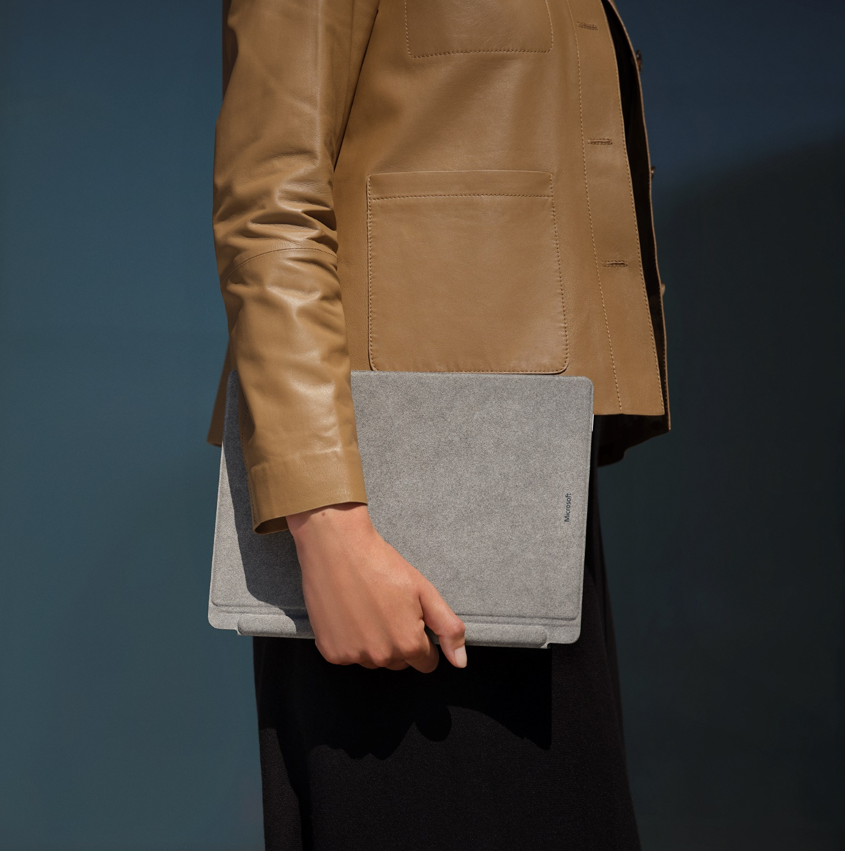

Modern devices for law firms
Legal
With accelerated digital transformation, empower legal professionals with a device portfolio that enables new AI experiences and secure productivity from anywhere.
Today’s workplace requires modern and secure devices that enable new AI experiences and work seamlessly with modern communications and collaboration tools to empower legal professionals and staff to be more productive and connect with colleagues and clients from anywhere.
“Consistency and reliability are essential for our people’s productivity, and we like that Surface Pro 7 devices behave the same whether in the office, at home, or at a client site. We’ve transformed our workplace with Surface Pro 7 because we know our staff have what they need to work, wherever they are.”
Microsoft Surface for Business offers a versatile device portfolio
with industry-leading security to empower legal professionals to work from anywhere while transforming core processes to better serve clients.
Light, versatile, powerful, and AI ready, Surface devices deliver a premium experience that fits the needs of all legal personas, from attorneys and partners to office managers, paralegals, and back-office staff.
Andrew Powell, Chief Information Officer, Macfarlanes
Surface devices with Windows 11 and Microsoft 365 help legal firms enable a modern workplace while mitigating risk with:
Productivity, collaboration, AI
Cloud-managed devices
Chip-to-cloud security
Experience the best of Microsoft—Microsoft 365, Dynamics 365, Azure, Windows 11, and Microsoft Copilot¹—on a Surface device. Surface + Microsoft Teams enable crystal clear meetings with high-end cameras, optimized microphones, and quality speakers. Enhance collaboration with AI-capabilities on Surface AI PCs and Copilot+ PCs.²
Enable work from anywhere while keeping control with zero-touch deployment and seamless device management. Employees just unbox and log in. Surface + Microsoft 365 gives employees the freedom to work their way and protection by the best modern security and manageability platform from Microsoft.
Security is built into every layer, from the supply chain to the firmware to the operating system, helping to keep data safer than ever. Surface powered by Microsoft 365 helps improve enterprise security. Secured-core PCs, available on select Surface devices, are designed to elevate the benefits of Windows 11 security.
Learn more about Surface for Business

Slide 2
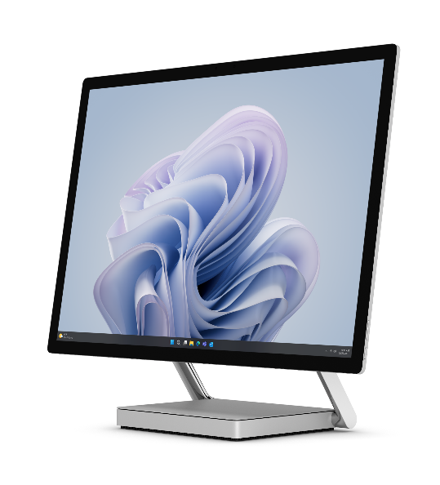
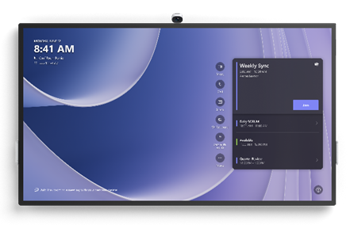
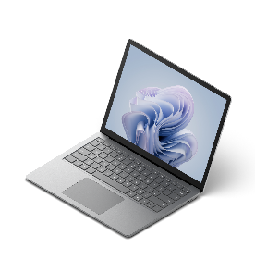
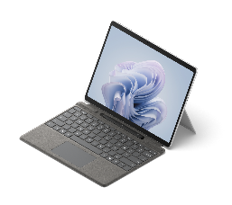
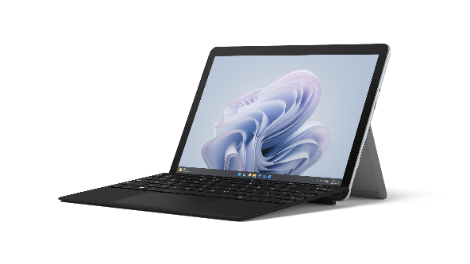




Legal
IMPORTANT:
Copilot in Windows is not available in all Surface markets. Do NOT message or depict Copilot in Windows features and functionality in markets where it is not support or will not be available at launch. For list of markets and required disclosures, go to: Copilot in Windows Storybook Guidance at: https://microsoft.sharepoint.com/teams/Windows11ConsumerStorybookHOL23/SitePages/Copilot%20in%20Windows%2011.aspx)
Disclaimer: Copilot for Microsoft 365 sold separately and requires a qualifying volume license or subscription. https://www.microsoft.com/microsoft-365/enterprise/copilot-for-microsoft-365. Copilot in Windows (in preview) is available in select global markets and will be rolled out to additional markets over time. Copilot with commercial data protection is available at no additional cost for users with an Entra ID enabled, eligible M365 license. Your AI-powered chat for the Web with commercial data protection | Microsoft Copilot (https://www.microsoft.com/en-us/bing/chat/enterprise/?form=MA13FV)
Go
Pro
Laptop
Studio
Hub
Partners and Attorneys
Paralegals
Challenges
Increasing hybrid work expectations require new digital requirements for client interactions and legal proceedings
Managing multiple cases and keeping teams in sync
Coordinating with both internal and external experts to determine the best strategy for clients’ legal matters
Documenting and storing sensitive information securely
Challenges
Keeping up with a wide variety of tasks including interviewing clients, performing research, and drafting legal documents
Coordinating case execution with attorneys and clients
Staying productive when away from the office or at home
Documenting and storing sensitive information securely
If you prefer to showcase Surface Laptop Copilot+ PC, swap in this copy
Deliver quality legal services for clients with
Surface Laptop Copilot+ PC
Premium design projects firm’s professional image
13.8” or 15” PixelSense™ Flow near-edgeless touchscreen display with adaptive color and contrast and HDR technology⁶
Responsive keys, backlit keyboard for typing accuracy
Powerful Snapdragon X Series processors with Qualcomm® Hexagon™ (NPU) with 45 TOPS to unlock new era of AI
AI-enhanced HD 1080p Surface Studio Camera with Windows Studio Effects to see and hear colleagues and clients clearly
The ultimate desktop experience with Windows 11 and USB-C® and Thunderbolt™ 4 ports
New Copilot Key⁴ on the Surface keyboard
A Secured-core PC to elevate Windows 11 security benefits
Deliver quality legal services for clients with
Surface Laptop 6
Premium design projects firm’s professional image
13.5” or 15” PixelSense™ anti-reflective touchscreen displays
Responsive, backlit keys for typing accuracy
Powerful Intel® Core™ Ultra processors to unleash a new era of productivity with intelligent assistance from Microsoft Copilot¹
AI-enhanced 1080p Studio Camera with Windows Studio Effects to see and hear colleagues and clients clearly on video calls
The ultimate desktop experience with Windows 11 and USB-C® and Thunderbolt™ 4 ports
New Copilot Key⁴ on the Surface keyboard
Smart card reader offered on 15" in US & Canada only
A Secured-core PC to elevate Windows 11 security benefits
Support attorneys and clients with Surface Pro 10
Lightweight, ultra-thin 2-in-1 device with all-day battery³ adapts to where and how paralegals work
Intel® Core™ Ultra processors with Intel® AI Boost NPU to run financial software, AI experiences, and Windows Studio effects
13” PixelSense™ anti-reflective touchscreen designed for Surface pen* is great for digital notetaking and e-signatures
High quality audio and video for more effective video calls
Rear-facing camera to capture and share photos of evidence
The ultimate desktop experience with Thunderbolt™ 4 or USB-C® ports and Windows 11
New Copilot Key⁴ on Surface Pro (and Pro Flex*) Keyboard
Built-in NFC card reader or Windows Hello for secure sign-in
A Secured-core PC to elevate Windows 11 security benefits
If you prefer to showcase Surface Pro Copilot+ PC, swap in this copy
Support attorneys and clients with Surface Pro Copilot+ PC
Powerful, ultra-thin, lightning-fast 2-in-1 with all-day battery³ adapts to where and how paralegals work
Snapdragon X Series processors with Qualcomm® Hexagon™ (NPU) with 45 TOPS to run business apps, AI experiences, and Windows Studio effects
13” PixelSense™ touchscreen designed for Surface pen*, great for paperless notetaking and e-signatures
High quality audio and video for more effective video calls
Rear-facing camera to capture and share photos of evidence
The ultimate desktop experience with Thunderbolt™ 4 or USB-C® ports and Windows 11
New Copilot Key⁴ on Surface Pro (and Pro Flex*) Keyboard
Built-in NFC card reader⁵ or Windows Hello for secure sign-in
A Secured-core PC to elevate Windows 11 security benefits
⁶ HDR requires HDR content and enabling HDR in device settings
Teams using conference rooms
Office Managers
Challenges
Connecting with colleagues in a hybrid work environment
Enabling virtual collaboration across multi-functional teams, external partners, and clients
Communicating case strategy and status with virtual clients
Challenges
Overseeing day-to-day firm operations
Managing increasing employee expectations
⁵ NFC is available on Wi-Fi configurations of Surface Pro Copilot+ PC.
Help modernize office services with
Surface Laptop Go 3
Portable design, durable finish, and all-day battery life³ makes it easy to carry and use around the office and at home
Powerful processors run legal software and intensive reports
12.4” PixelSense™ high-resolution touchscreen and full-size keyboard to create and view office plans
HD camera, optimized microphones, and quality speakers to look and sound clear on video calls
USB-C and USB-A ports for connecting to device peripherals
A Secured-core PC to elevate Windows 11 security benefits
Empower team collaboration in hybrid world with
Surface Hub 3
Join a Microsoft Teams meeting with one touch
Microsoft Teams-certified meetings platform + high-end cameras, optimized microphones, and quality speakers
enables effective hybrid (in-person + remote) meetings
Large, 4K screen to share case updates with clients
85” for large-room solution, 50” for smaller spaces
Pen, inking, and whiteboard capabilities to plan case strategy
Wall-mounted or lightweight and mobile (with stand + battery*) to make any space a teamwork space
* Sold separately.
¹ Microsoft Copilot for Microsoft 365 requires a qualifying volume license or subscription. See more Microsoft Copilot for Microsoft 365 | Microsoft 365. Copilot in Windows (in preview) is available in select global markets and will be rolled out to additional markets over time. Copilot with commercial data protection is available at no additional cost for users with an Entra ID enabled, eligible M365 license. Your AI-powered chat for the Web with commercial data protection | Microsoft Copilot
² Surface AI PCs include Surface Pro 10, Surface Laptop 6, Surface Pro 9 with 5G, Surface Studio Laptop 2. Surface Copilot+ PCs include Surface Pro and Surface Laptop.
³ Battery life varies significantly based on usage, network and feature configuration, signal strength, settings and other factors. See aka.ms/SurfaceBatteryPerformance for details.
⁴ Feature availability varies by market, see aka.ms/WindowsAIFeatures. When Copilot for Windows is not available or enabled on the device, pressing the Copilot key will launch Windows Search.

