Slide 1



Modern devices for government
Government
With accelerated digital transformation, empower government officials and employees with a device portfolio that enables new AI experiences and secure productivity from anywhere.
Today’s workplace requires modern and secure devices that enable new AI experience and work seamlessly with modern communications and collaboration tools to empower government employees to work and connect with colleagues and citizens from anywhere.
“We piloted the devices with our technology champions across the organisation, so we had a view from our user base – and Microsoft Surfaces were the preferred devices.”
Microsoft Surface for Business offers a versatile device portfolio with industry-leading security to empower government workers to work from anywhere while transforming core processes to better serve citizens.
Light, versatile, powerful, and AI ready, Surface devices deliver a premium experience that fits the needs of all government personas, from frontline workers (police, fire, emergency, inspectors, case workers) to government officials (city planners, judiciary, legislators, treasurers) and back-office staff.
Sarah Moore – IT Transformation Manager, Somerset County Council
Surface devices with Windows 11 and Microsoft 365 help empower digital transformation in government organizations with:
Productivity, collaboration, AI
Cloud-managed devices
Chip-to-cloud security
Experience the best of Microsoft—Microsoft 365, Dynamics 365, Azure, Windows 11, and Microsoft Copilot¹—on a Surface device. Surface + Microsoft Teams enable crystal clear meetings with high-end cameras, optimized microphones, and quality speakers. Enhance collaboration with AI-capabilities on Surface AI PCs and Copilot+ PCs.²
Enable work from anywhere while keeping control with zero-touch deployment and seamless device management. Dispersed workers just unbox and log in. Surface + Microsoft 365 gives employees the freedom to work their way and protection by the best modern security and manageability platform from Microsoft.
Security is built into every layer, from the supply chain to the firmware to the operating system, helping to keep data safer than ever. Surface powered by Microsoft 365 helps improve enterprise security. Secured-core PCs, available on the latest Surface devices, are designed to elevate the benefits of Windows 11 security.
Learn more about Surface for Business and Surface for Public Safety

Slide 2
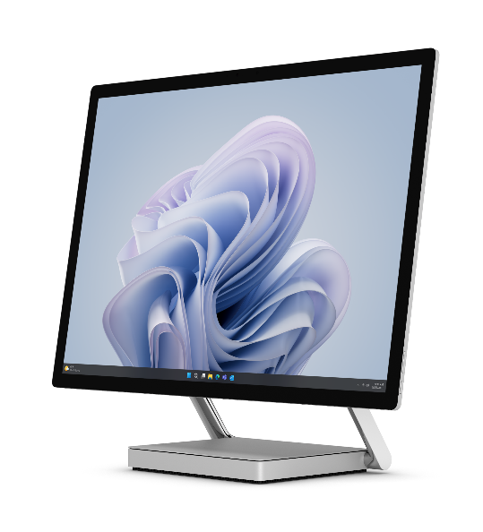
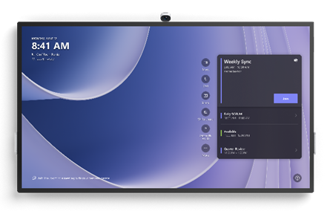
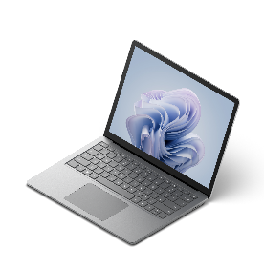
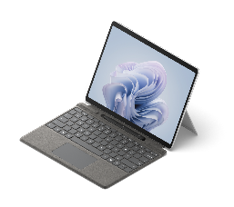
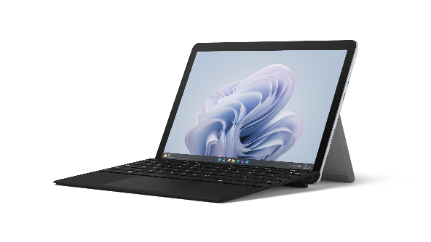




Government
IMPORTANT:
Copilot in Windows is not available in all Surface markets. Do NOT message or depict Copilot in Windows features and functionality in markets where it is not support or will not be available at launch. For list of markets and required disclosures, go to: Copilot in Windows Storybook Guidance at: https://microsoft.sharepoint.com/teams/Windows11ConsumerStorybookHOL23/SitePages/Copilot%20in%20Windows%2011.aspx)
Disclaimer: Copilot for Microsoft 365 sold separately and requires a qualifying volume license or subscription. https://www.microsoft.com/microsoft-365/enterprise/copilot-for-microsoft-365. Copilot in Windows (in preview) is available in select global markets and will be rolled out to additional markets over time. Copilot with commercial data protection is available at no additional cost for users with an Entra ID enabled, eligible M365 license. Your AI-powered chat for the Web with commercial data protection | Microsoft Copilot (https://www.microsoft.com/en-us/bing/chat/enterprise/?form=MA13FV)
Go
Pro
Laptop
Studio
Hub
Government officials & staff
Emergency response (Police, Fire, etc.)
Challenges
Managing multiple programs and keeping teams in sync
Coordinating with both internal and cross-agency experts to determine the best strategy for citizen services
Staying productive when away from the office or at home
Documenting and storing sensitive information securely
Challenges
Increasing citizen expectations require new requirements for mobility, connectivity, cross-agency collaboration and devices
First responders struggle to connect when away from office
Frontline services are still manual, paper-based processes
If you prefer to showcase Surface Pro Copilot+ PC, swap in this copy
Deliver quality public programs and services with
Surface Pro Copilot+ PC
Powerful, ultra-thin, lightning-fast 2-in-1 with all-day battery³ enables government officials and staff to work in new ways
Snapdragon X Series processors with Qualcomm® Hexagon™ (NPU) with 45 TOPS to run business apps, AI experiences, and Windows Studio effects
13” PixelSense™ touchscreen designed for Surface pen*, great for paperless notetaking and e-signatures
High quality audio and video for more effective video calls
The ultimate desktop experience with Thunderbolt™ 4 or USB-C® ports and Windows 11
New Copilot Key⁴ on Surface Pro (and Pro Flex*) Keyboard
Built-in NFC card reader⁵ or Windows Hello for secure sign-in
A Secured-core PC to elevate Windows 11 security benefits
Deliver quality public programs and services with
Surface Pro 10
Lightweight, ultra-thin 2-in-1 device with all-day battery³ adapts to where and how government officials and staff work
Intel® Core™ Ultra processors with Intel® AI Boost NPU to run business apps, AI experiences, and Windows Studio effects
13” PixelSense™ anti-reflective touchscreen designed for Surface pen*, great for digital notetaking and e-signatures
High quality audio and video for more effective team collaboration and training
The ultimate desktop experience with Thunderbolt™ 4 or USB-C® ports and Windows 11
New Copilot Key⁴ on Surface Pro (and Pro Flex*) Keyboard
Built-in NFC card reader or Windows Hello for secure sign-in
A Secured-core PC to elevate Windows 11 security benefits
Transform emergency response with Surface Go 4
The smallest and lightest Surface 2-in-1, rugged cases,* and extended battery life³ makes it easy to use in the field
Faster processor speed (than previous Surface Go) run government-critical software and productivity apps
10.5” PixelSense™ high-resolution touchscreen to view maps and images and share forms with citizens in brilliant detail
Surface Pen* for citizen e-signatures (go paperless)
Quality speakers, mics, and cameras for improved communications with command or cross-agency task forces
Built-in NFC card reader or Windows Hello for secure sign-in
A Secured-core PC to elevate Windows 11 security benefits
Judges, clerks, court administrators
City planners
Challenges
Increasing citizen expectations has created new requirements for digital judiciary services, such as virtual court proceedings
Communicating with government agencies and attorneys
Judicial services are still manual, paper-based processes
⁵ NFC is available on Wi-Fi configurations of Surface Pro Copilot+ PC.
Challenges
Connecting with colleagues in a hybrid work environment
Enabling collaboration across multi-functional teams and external development partners
Communicating project status with citizens and stakeholders
If you prefer to showcase Surface Laptop Copilot+ PC, swap in this copy
Modernize court operations with Surface Laptop 6
Sleek and portable design and all-day battery life³ is ideal for carrying device between court rooms, offices, and home
13.5” or 15” PixelSense™ anti-reflective touchscreen displays
Powerful Intel® Core™ Ultra processors to unleash a new era of productivity with intelligent assistance from Microsoft Copilot¹
AI-enhanced 1080p Studio Camera with Windows Studio Effects for effective communications and virtual court proceedings
The ultimate desktop experience with Windows 11 and USB-C® and Thunderbolt™ 4 ports
New Copilot Key⁴ on the Surface keyboard
Smart card reader offered on 15" in US & Canada only
A Secured-core PC to elevate Windows 11 security benefits
Modernize court operations with Surface Laptop Copilot+ PC
Sleek and ultra-thin design and all-day battery life³ is ideal for carrying device between court rooms, offices, and home
13.8” or 15” PixelSense™ Flow near-edgeless touchscreen display with adaptive color and contrast and HDR technology⁶
Powerful Snapdragon X Series processors with Qualcomm® Hexagon™ (NPU) with 45 TOPS to unlock new era of AI
AI-enhanced HD 1080p Surface Studio Camera with Windows Studio Effects to see and hear virtual court proceedings clearly
The ultimate desktop experience with Windows 11 and USB-C® and Thunderbolt™ 4 ports
New Copilot Key⁴ on the Surface keyboard
A Secured-core PC to elevate Windows 11 security benefits
Empower team collaboration to deliver city-wide urban innovations with Surface Hub 3
Microsoft Teams-certified meetings platform + high-end cameras, optimized microphones, and quality speakers enables effective hybrid (in-person + remote) meetings
Large, 4K screen to share project status with stakeholders
85” for large-room solution, 50” for smaller spaces
Pen, inking, and whiteboard capabilities to ideate new plans
Wall-mounted or mobile (with stand + battery*)
* Sold separately.
¹ Microsoft Copilot for Microsoft 365 requires a qualifying volume license or subscription. See more Microsoft Copilot for Microsoft 365 | Microsoft 365. Copilot in Windows (in preview) is available in select global markets and will be rolled out to additional markets over time. Copilot with commercial data protection is available at no additional cost for users with an Entra ID enabled, eligible M365 license. Your AI-powered chat for the Web with commercial data protection | Microsoft Copilot
² Surface AI PCs include Surface Pro 10, Surface Laptop 6, Surface Pro 9 with 5G, Surface Studio Laptop 2. Surface Copilot+ PCs include Surface Pro and Surface Laptop.
³ Battery life varies significantly based on usage, network and feature configuration, signal strength, settings and other factors. See aka.ms/SurfaceBatteryPerformance for details.
⁴ Feature availability varies by market, see aka.ms/WindowsAIFeatures. When Copilot for Windows is not available or enabled on the device, pressing the Copilot key will launch Windows Search.
⁶ HDR requires HDR content and enabling HDR in device settings

